Slide 1
CSS Selector Review
Layout with CSS & Flex
Lecture 4

Slide 2
CSS Selectors Review
Classification | Description | Example
Type selector | Selects an element type | p
Class selector | Selects all elements with the given class attribute value | .koala-face
ID selector | Selects the element with the unique id attribute value | #scientific-name
We can also combine selectors:
.bordered selects all elements with the bordered class
h2.bordered selects only h2 elements with the bordered class

Slide 3
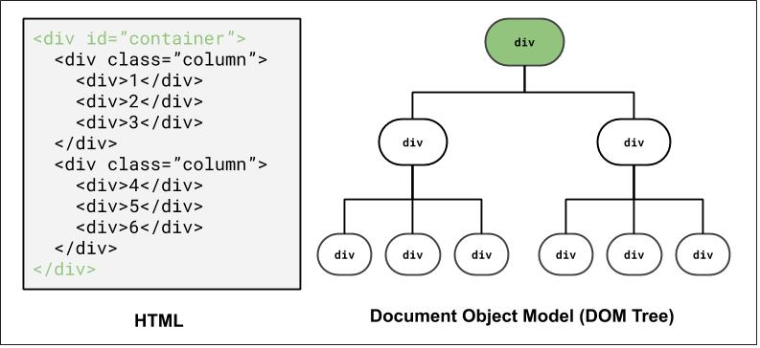
DOM and Selectors: Q1
How to select the highlighted elements?
Using ID selector: #container

Slide 4
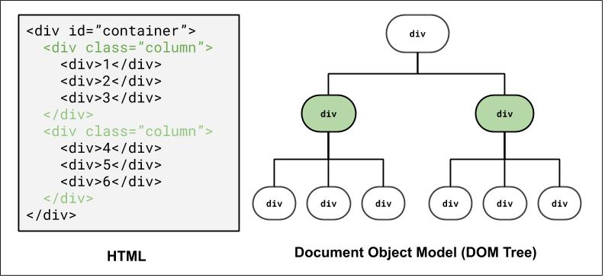
DOM and Selectors: Q2
How to select the highlighted elements?
Using class selector: .column
Using combinator selector: #container > div

Slide 5
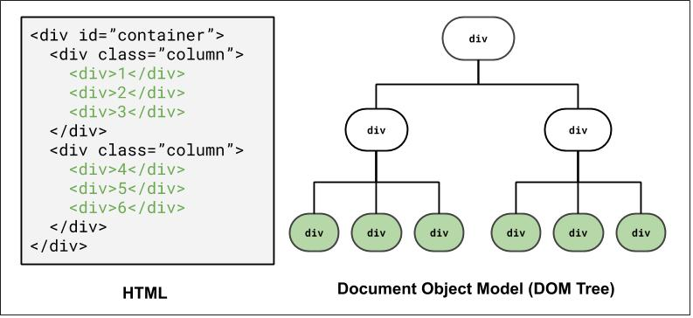
DOM and Selectors: Q3
How to select the highlighted elements?
Using class and descender combinator selector: .column div
Using a class and child combinator selector: #container > div > div

Slide 6
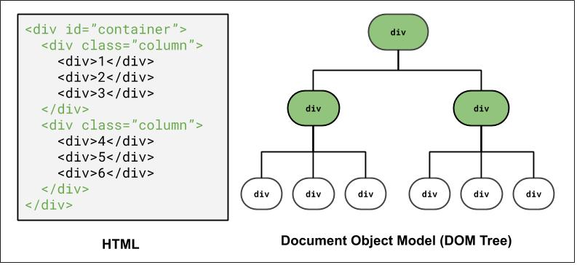
DOM and Selectors: Q4
How to select the highlighted elements?
Grouping elements: #container, .column

Slide 7
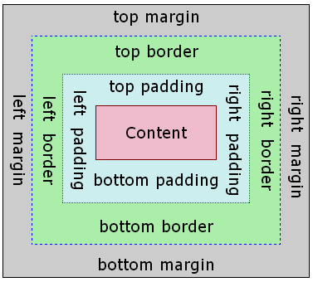
The Box Model
Margin: (outside) space between different elements
Border: (optionally visible) line that separates elements
Padding: (inside) space between element content and border

Slide 8
Why page layout is important
Example 1: Click here for an example of poor HTML tags, layout, and accessibility (try resizing the page). The “old days” of layout.
Inspect?: table, table, table, table…
Example 2: This is the official HealthCare.gov webpage from 2018, where all kinds of users rely on for health care information.
Some visually-impaired users need larger font sizes on the screen.
What happens to the search bar when you increase the font size?
As a user, have you ever left a website (that may be useful) because of the layout or accessibility?
There's a lot of very cool research on verifying page layout!

Slide 9
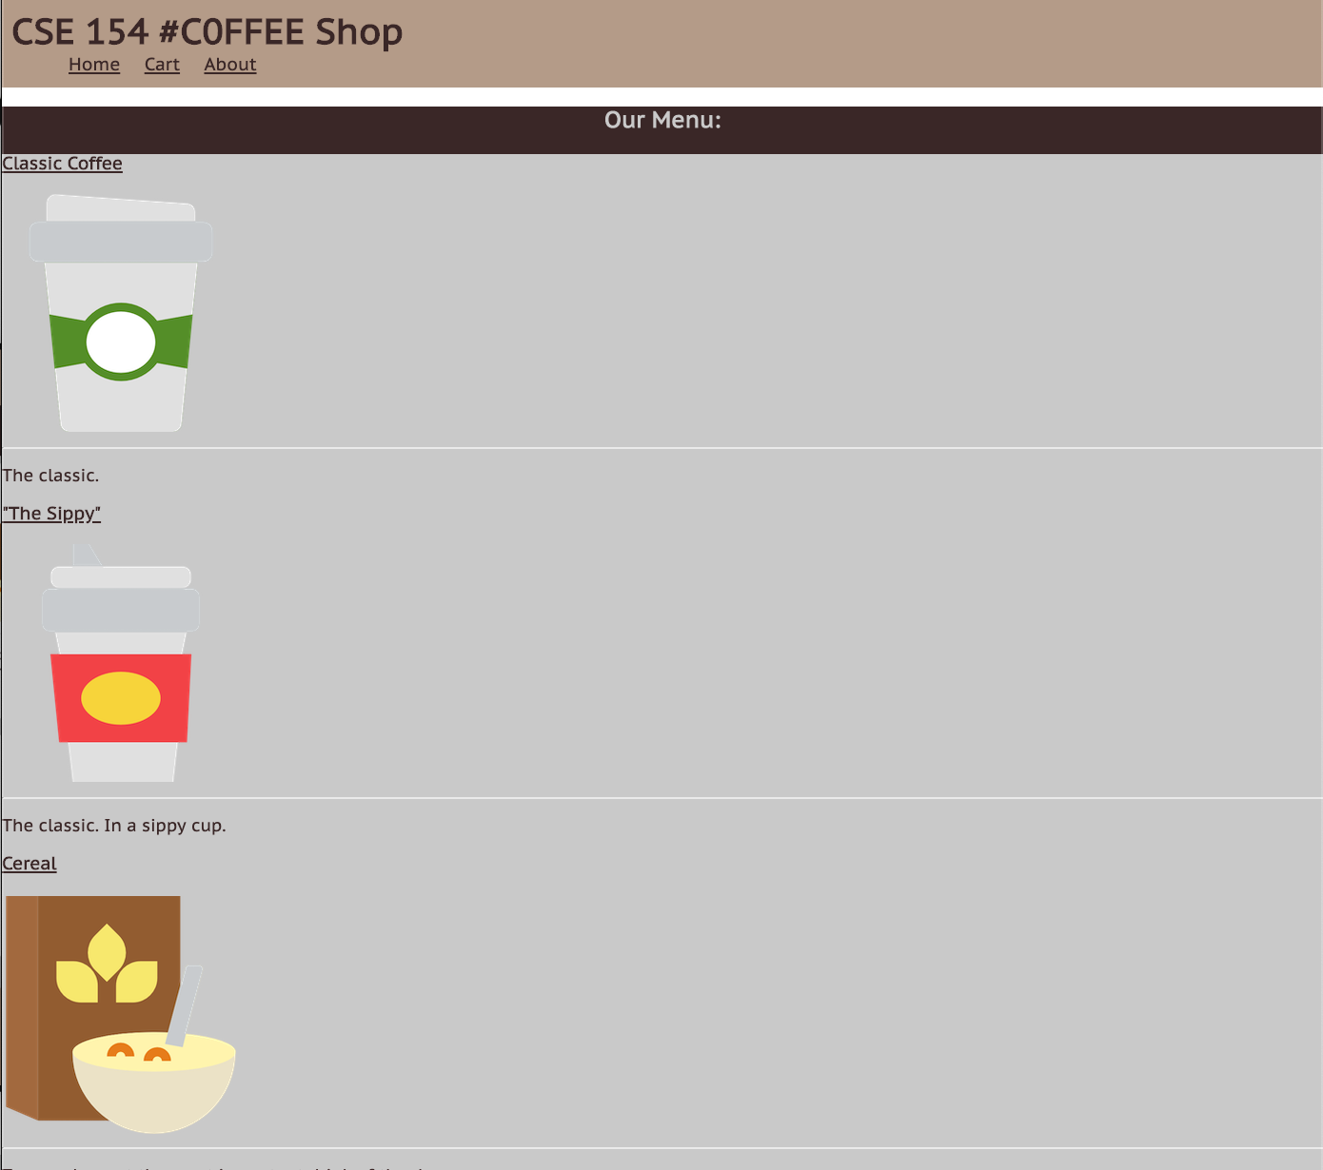
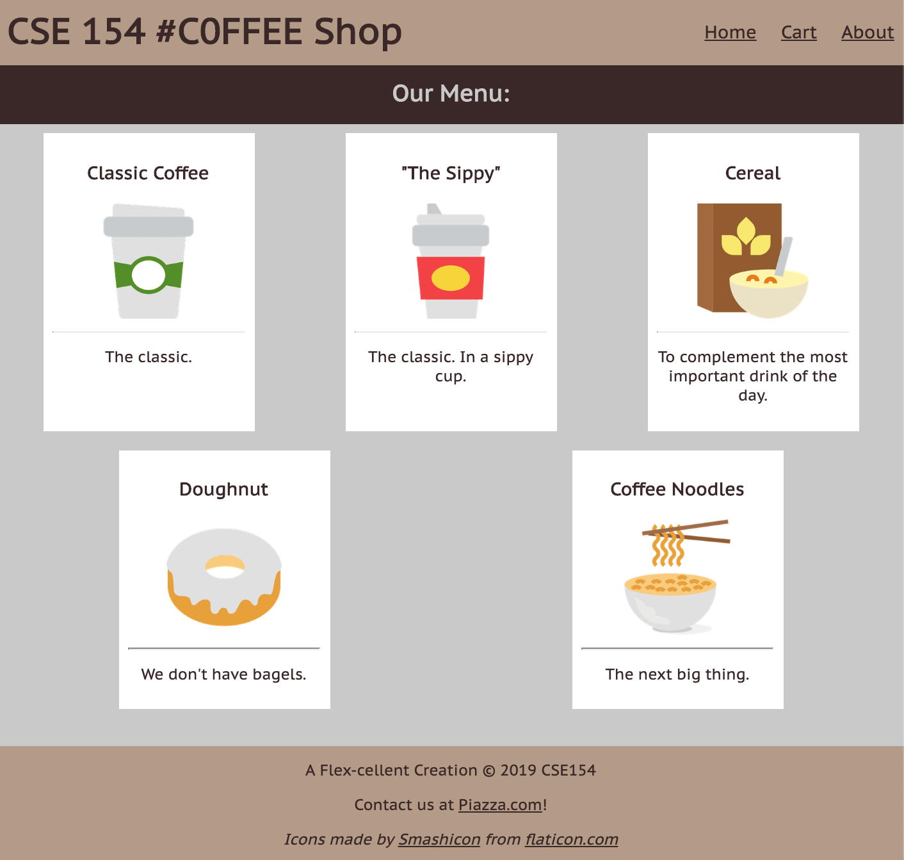
The Goal: Clean Layout, Responsive Design
Today, we'll learn the fundamentals of various layout techniques to go from the left initial product (no layout CSS) to the final product (to the right, link TBD)

Slide 10
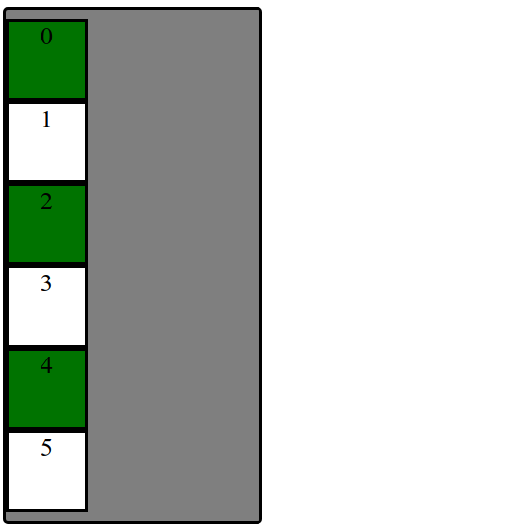
Starting with Building Blocks
<div id="container">
<div>1</div>
<div>2</div>
<div>3</div>
<div>4</div>
<div>5</div>
<div>6</div>
</div>

Slide 11
Why are we playing with boxes?
When learning CSS layout, you'll find there are many ways to layout your pages.
"Boxes" are great to practice with for comparing different layout strategies and better understanding the box model.
We are also working with text inside of each div to demonstrate block vs. inline layout.
In practice, it's useful to:
Treat page elements as boxed regions to figure out the page layout
Then focus on more specific CSS styling

Slide 12
(Older) Layout Method: Floating Elements
A way to remove elements from the normal document element flow, usually to get other elements to "wrap" around them.
Can float left, right (no center)

Slide 13
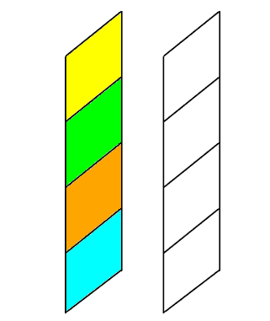
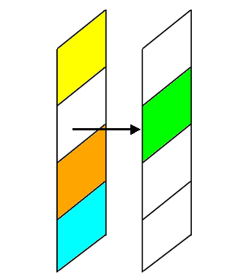
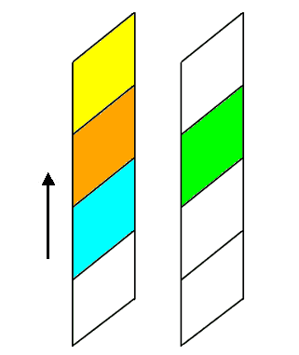
An analogy: Page Layers as Sheets of Paper

Slide 14
Example with Float
There is a blue block has the float CSS property set to left. This tells the browser to give the element as much space as it needs, and then start bringing the next content up from below and fill in remaining space.
See the Pen - Box Float by @mehovik on Codepen.
Add overflow: auto; to make the parent of a floating element contain the floating element.

Slide 15
And that’s a wrap on float :)
This is not an exhaustive introduction to float. There is SO much more to learn about float as well as some other good use cases for float as well. However, our focus for layout will be on the box model and using flex. If you’d like to learn more about float post on Ed, ask in OHs or go to WPL.

Slide 16

Distributing Boxes Evenly in a Container
How could we distribute boxes across box container evenly (equal space between each box)?.
... what should we do about the margins of the boxes?
... what value do we put?
... how many screen sizes will we try on?

Slide 17
display Property
The display property specifies the display behavior (the type of rendering box) of an element. The four values you most often will see are:
inline: Displays an element as an inline element, spanning the width/height of its content. Any height and width properties will have no effect.
block: Displays an element as a block element. It starts on a new line, and takes up the width of the parent container.
none: The element is completely removed.
flex: Displays an element as a block-level flex container.
grid: Displays elements in a 2-dimensional grid.

Slide 18
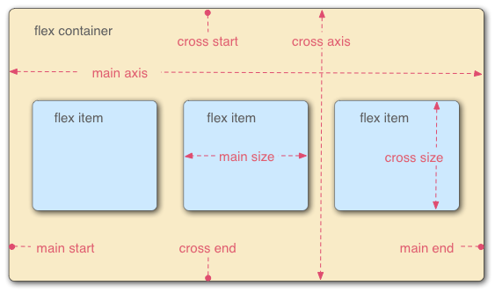
Flexbox
Flexbox is a set of CSS properties for aligning block level content.
Flexbox defines two types of content - "containers" and "items".
Anything directly nested inside of a flex container becomes a flex item.
Various properties on the container can be set to determine how its items are laid out.

Slide 19
Basic properties for the flex container
display: flex;
makes an element a "flex container", items inside automatically become "items" - by default, starts as a row
justify-content: flex-end; (flex-start, space-around,...)
indicates how to space the items inside the container along the main axis
align-items: flex-end; (flex-start, center, baseline,...)
indicates how to space the items inside the container along the cross axis
flex-direction: row; (column)
indicates whether the container flows horizontally or vertically (default row)
flex-wrap: wrap; (no-wrap, ...)
indicates whether the container's children should wrap on new lines

Slide 20
Basic properties for the flex container
There are also cases when you will need to add flex properties to flex items rather than the flex container
flex-grow: <number>
Defines a proportional value to determine whether a flex items can grow (what amount of the available space inside the container it should take up).
flex-basis: 20%; (3em, 50px,...)
indicates the default size of an element before the extra space is distributed among the items
align-self: flex-end; (flex-start, center, stretch,...)
indicates where to place this specific item along the cross axis

Slide 21
Back to the boxes
Exercise: distribute boxes across box container evenly (equal space between each box) using flex.
solution

Slide 22
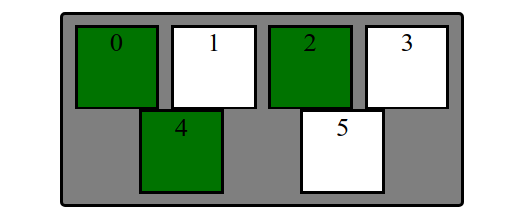
Exercise: Responsive Page Layout - Wrapping
Set boxes to wrap when box container gets too small in the browser so that they keep their square widths (what happens when you shrink the browser width in the previous exercise?).
solution

Slide 23
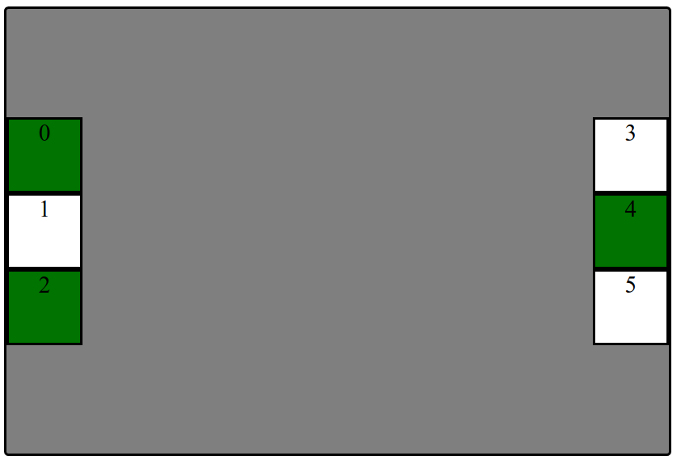
Extra Practice (for flex masters): more fancy stuff
Layout boxes into two 3-box columns using flex (use screenshot with given details). Note: don't rely too much on previous CSS solutions - you'll need to change the HTML slightly as well to get the columns grouped)
In the HTML, make boxes grouped in two 3-box columns (hint: add a class to both groupings called "column").
Change height of #container to 500px and center the columns vertically
Distribute the two columns on both left/ends of the #container.
solution

Slide 24
From Boxes to a “Real” Example
How can we use these different layout methods in pages with components like header, main, footer? What about side-by-side sections? Inline navigation with lists?

Slide 25
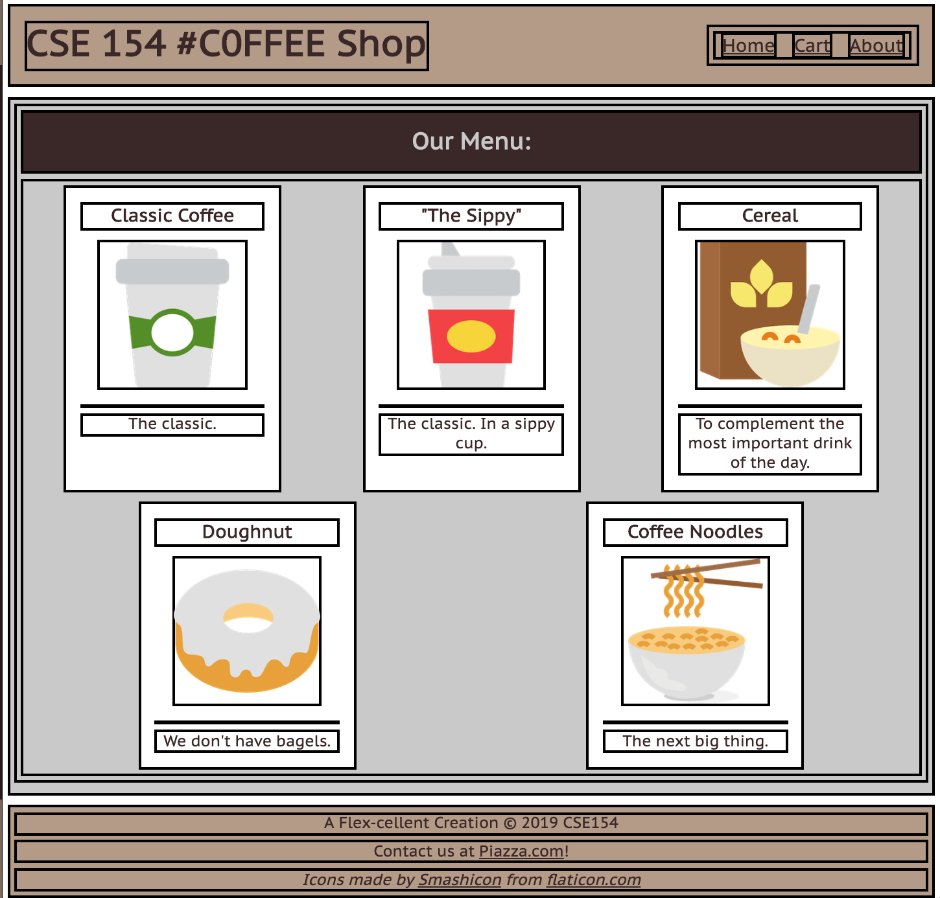
What columns & rows exist in the cafe page?
What are the parent "containers" distributing items in a row/column?
body (column with 3 children)
#top-bar header (row with 2 children)
#item-container (row with 5 children)
footer (column with 3 children)
We’ll take an “outside-in” approach, starting with the body

Slide 26
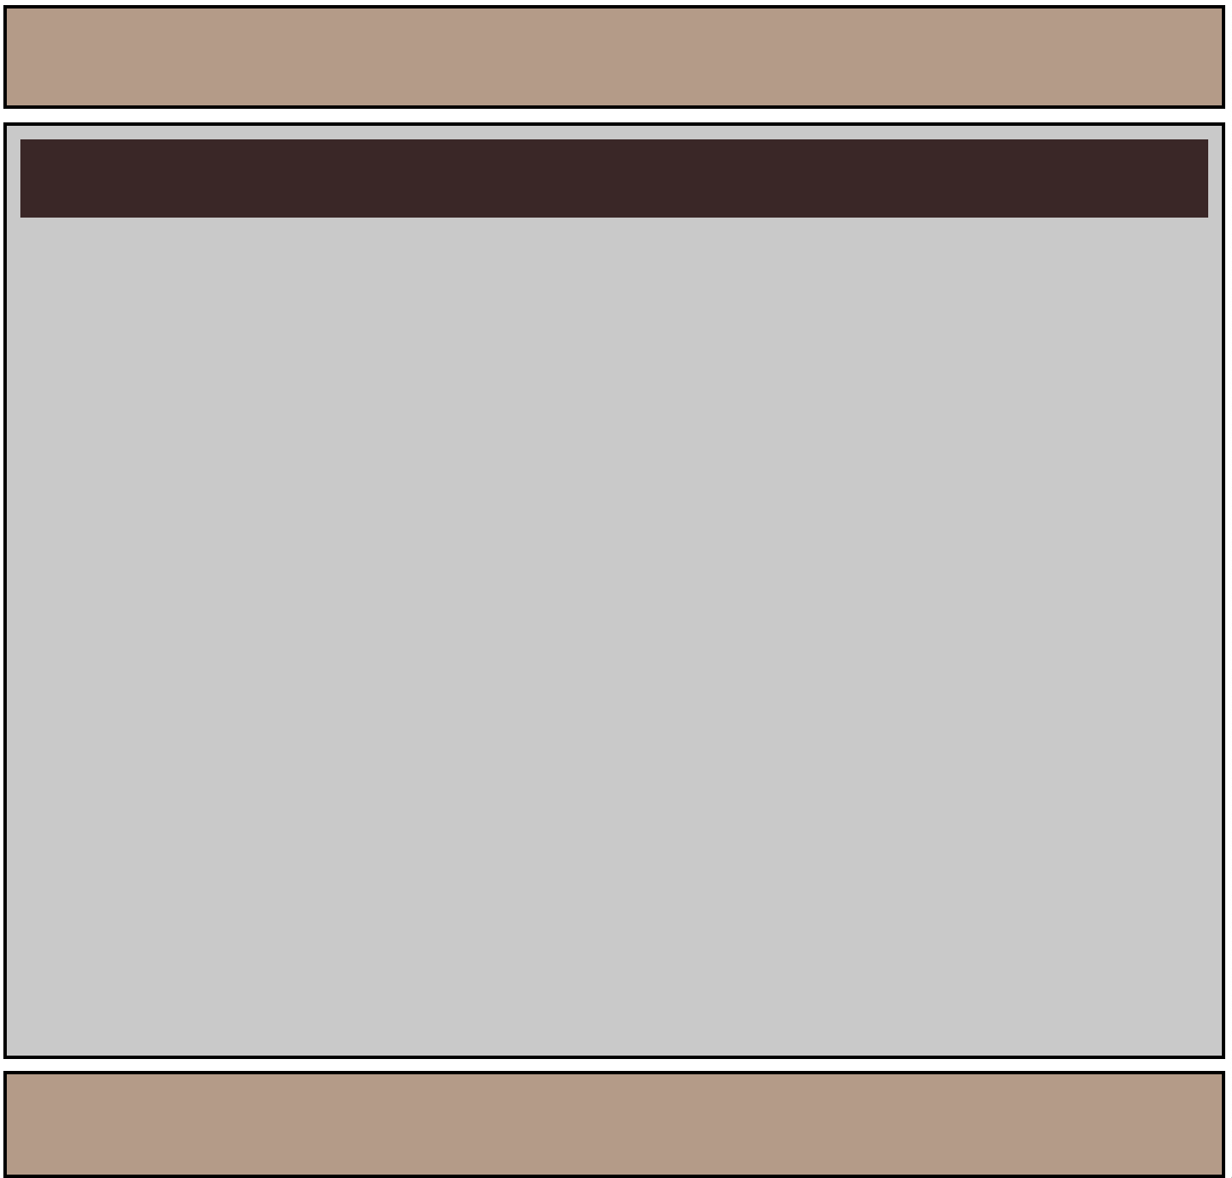
Body Layout: A Column

Slide 27
Figuring out the Flex Layout
For the body, we know we want a column.
We already get a column layout from the default block display for header, main, footer.
But by default, these elements will have a height defined by their contents. This will result in whitespace at the bottom of the page.
We can use flex to control the distribution of the body's children to fill the entire page!

Slide 28
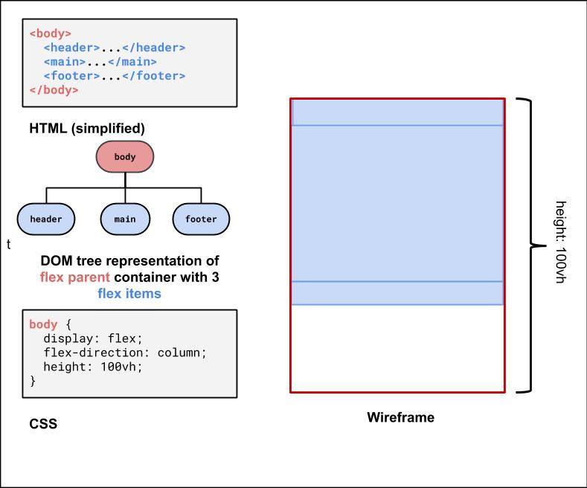
Making the Body a Flex Column
Many page layouts desire a full viewport height (vh) with a footer at the bottom.. To set the body to be 100% of the viewport height, use the vh size unit.

Slide 29
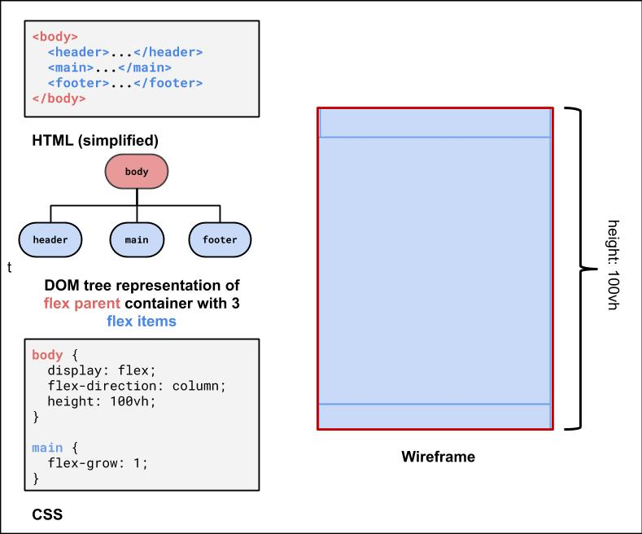
Using flex-grow with column page layout
Next, we can use flex-grow: 1 on the child element of the body flex container to have that child fill any remaining whitespace (the default for flex-grow for all items is 0). Let's make the main child fill the rest of the whitespace of the parent

Slide 30
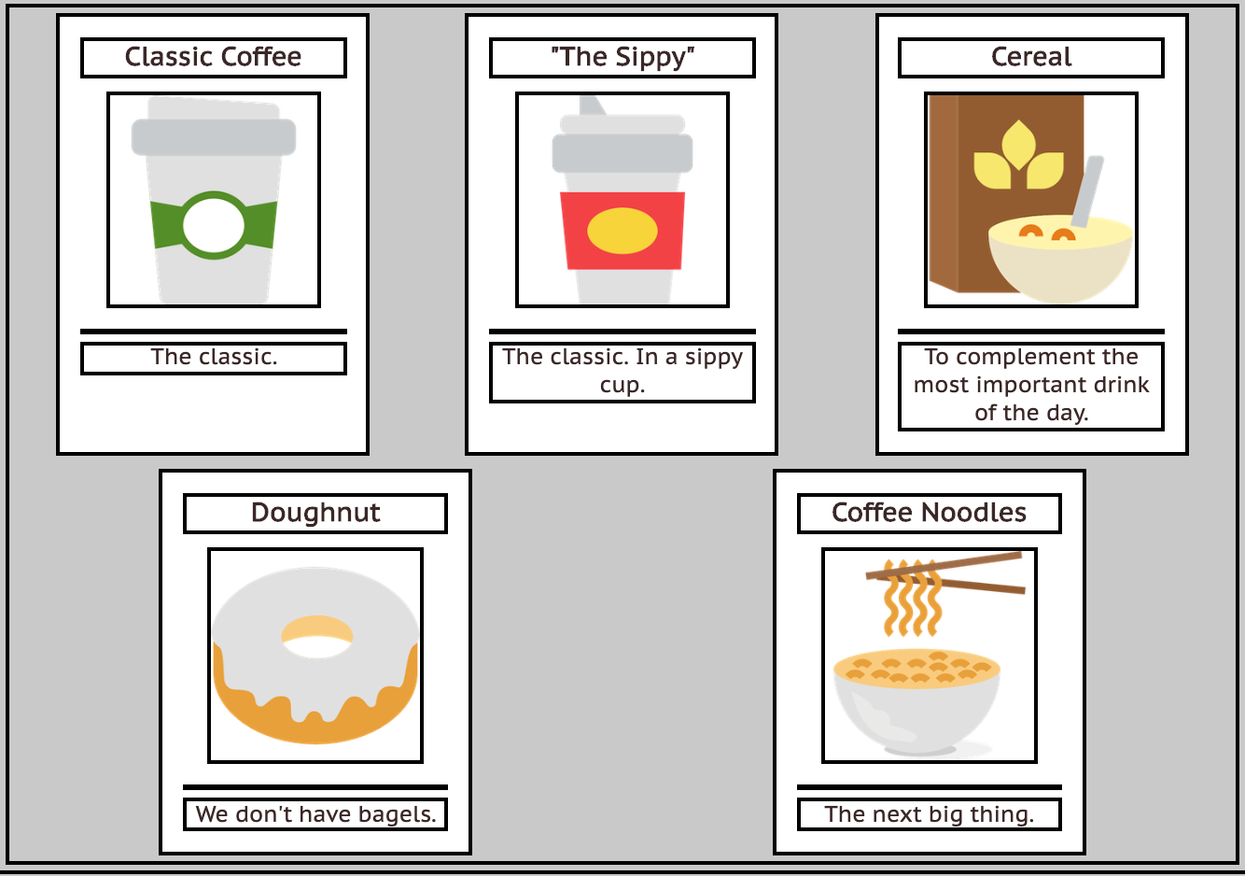
Second Flex Container: #item-container
This is the div that holds all of the product article "cards". It would be nice to have some control over their distribution, and wrap them when the screen gets smaller.
<div id="item-container">
<article>...</article>
<article>...</article>
<article>...</article>
<article>...</article>
<article>...</article>
</div>

Slide 31
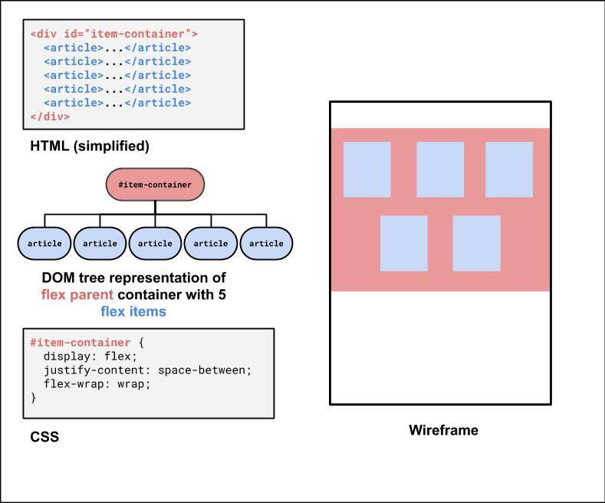
#item-container Solution

Slide 32
Third Flex Container: The #top-bar
<header id="top-bar">
<h1>...</h1>
<nav>...</nav>
</header>
This is a bit of a trickier one, so it's good to do it last. We want to make it a flex row so we can get a nice distribution of space between the h1 and the nav.
We'll also make the #top-bar a sticky nav bar, so it sticks to the top when you scroll down!
With careful planning, we can combine different layout techniques like display: flex; and position: sticky.
Let's take a look more closely at the CSS position property.

Slide 33
positioning Elements
position: static
Default value. Elements render in order, as they appear in the document flow
position: fixed
Puts an element at an exact position within the browser window
position: absolute
Puts an element at an absolute position based on the location of the element's parent container
position: relative
Makes children positioned relative to the parent container
Handy for sticking a footer to the bottom of a page, for example
position: sticky
A "hybrid" - toggles between relative and fixed depending on scroll position
Another good explanation is here

Slide 34
Using position: sticky for the header/footer
A sticky element toggles between relative and fixed depending on the scroll position - is fixed when a given offset position (e.g. top of 0) is met in the viewport
See the Pen Sticky Examples by @mehovik on CodePen

Slide 35
Review: Box Model Properties
The box model is a way of representing the space that an element takes up on a page, and how it relates to other elements.
Width/Height
Padding
Border
Margin

Slide 36
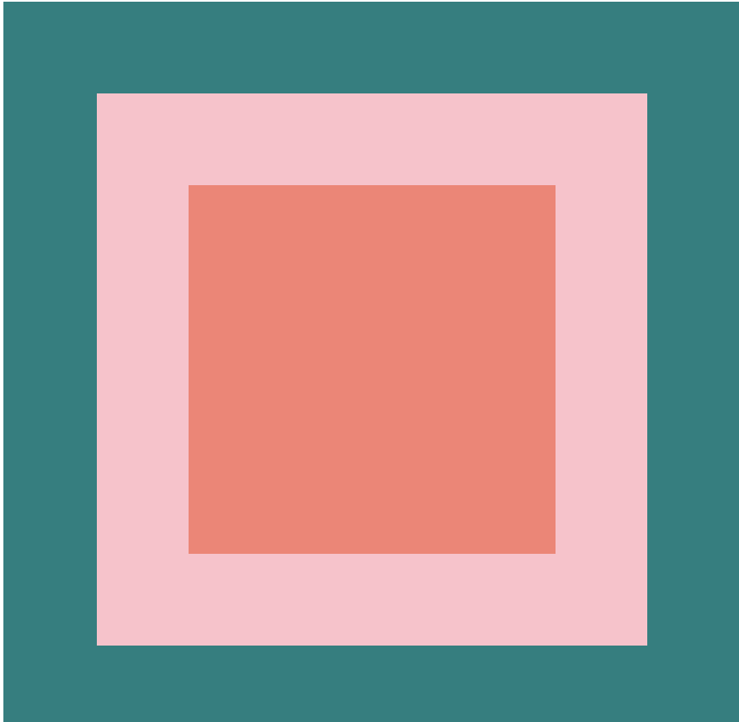
Boxes
Given boxes.html, write boxes.css to make the appearance below
The padding of the outer box is teal with a width of 50 pixels.
The border of the inner box is pink with a width of 50 pixels.
The background color of the inner box is salmon with a width and height of 200 pixels.
The overall box has a total width and height of 400 pixels.
(solution)

Slide 37
Introduction to Flex
Flexbox is a set of CSS properties for aligning block level content.
Flexbox defines two types of content
"Container": The parent block element
"Items": anything directly nested inside of a flex container becomes a flex item.
Various properties on the container determine how its items are layed out.

Slide 38
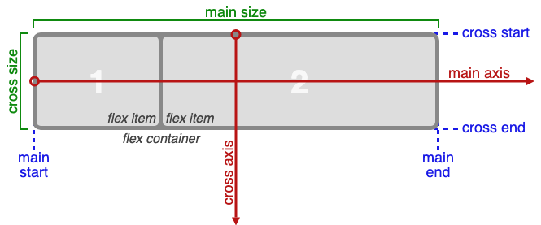

Slide 39
Basic Properties of Flex Container
display: flex;
makes an element a "container", items inside automatically become "items"
justify-content: flex-end; (flex-start, space-around,...)
indicates how to space the items inside the container along the main axis
align-items: flex-end; (flex-start, center, baseline,...)
indicates how to space the items inside the container along the cross axis
flex-direction: row; (column)
indicates whether the container flows horizontally or vertically

Slide 40

Flex with Number Card
The card container is represented using a div and has 4 images, each representing a number. This card should be 500px wide and 200px tall with a solid #698733 border of 0.5em width and a border-radius of 1em.
The four images in the card should take up 70% of the height of the card, be centered vertically within, and spaced-evenly horizontally.
(starter files) & (solution)

Slide 41
Flex with Number Card (challenge!)
Once you've finished this exercise to get the expected output, how can you modify your CSS to get the numbers in the order "3 2 1 0"? How about "2 3 1 0"? For the second ordering, try to use the order property.

Slide 42
Extra Practice: more flexbox resources
Weird-flex
A visual aid for learning and seeing flex properties in action. Made by Chao, a CSE 154 TA!
Flexbox ducky
a CSS game for learning the basics of Flexbox. It's fairly self-contained, but feel free to talk to your neighbors with any questions or let your TA know if you run into anything you're not sure about along the way!
CSS-Tricks Guide to Flexbox
goes into a deeper explanation of the flex properties and has some great examples to compare each - it's a great bookmark resource to reference for this class!

